Slide 1
Personal Finance Management System
Submitted to:-
Dr. Amit Kukker
Submitted by:-
PRANJAL UPADHYAY
(RA2311003030063)

Slide 2
Introduction
A Personal Finance Management System using DBMS helps users effectively track and manage their income, expenses, and savings. By using a Database Management System, the application ensures secure, organized, and efficient storage and retrieval of financial data..
It allows users to:
Monitor spending habits
Set budgets
Generate financial reports
This system demonstrates the practical use of DBMS concepts like:
Relational modeling

Slide 3
Introduction(cont.)
Queries
Data integrity
Key Features:
Income & Expense Tracking – Add, update, and view all transactions.
Category Management – Classify transactions into categories like Rent, Food, Investment, etc.
Dashboard Overview – View total income, expenses, and net balance at a glance.
Charts & Visual Analytics – Includes pie charts, bar graphs, and radar charts for insights.
Financial Calculators – SIP, IRR, Future Value, Withdrawal planning, and more.
AI Analysis – Offers insights into essential vs non-essential spending, savings rate, and financial health.

Slide 4
Problem description problem identification :
In today’s fast-paced world, many individuals struggle to manage their personal finances effectively. Traditional methods like manual record-keeping or spreadsheets are prone to errors, lack real-time insights, and are difficult to maintain over time. Without a structured and automated system, users find it challenging to track income, monitor expenses, set budgets, and analyze their financial habits. This results in poor financial planning, overspending, and missed opportunities for saving and investment
Managing personal finances manually using spreadsheets or notebooks :
Error-prone
Time-consuming
Lacks real-time insights
Hard to scale or maintain over time

Slide 5
Problem description(cont.) proposed solution:
To address these challenges, we developed a Personal Finance Management System (PFMS) using a Database Management System (DBMS). This system offers users a centralized platform to:
Track income, expenses, and savings efficiently
Categorize financial data for better understanding and reporting
Generate real-time visual analytics like charts and graphs
Set and monitor budgets with ease
Export and import data for flexible data management
Ensure data security and integrity using structured queries and relational modeling

Slide 6
entity
Core Entities in Personal Finance Management System
User 👤 -
Attributes: User_ID, Name, Email, Password
Role: Represents an individual using the system. All records are linked to a user.
Transaction 💸 -
Attributes: Transaction_ID, Title, Amount, Date, Category_ID, Type (Income/Expense), User_ID
Role: Logs financial entries like income and expenses.
Category 📂 -
Attributes: Category_ID, Category_Name, Type (Income/Expense)
Role: Helps organize transactions (e.g., Rent, Salary, Groceries).

Slide 7
entity
Account 💳
Attributes: account_id, user_id, account_name, balance, created_at, updated_at
Role: Represents a user's financial account, such as a bank account or wallet. Used to track balances and linked to budgets.
Budget 💸
Attributes: budget_id, user_id, category_id, account_id, amount, start_date, end_date, created_at, updated_at
Role: Represents a spending limit set by a user for a specific category and account, helping track financial allocations over time.

Slide 8






Entities in factory management system

Slide 9
budget Entity:
Attributes:
budget_id (Primary Key)
user_id
category_id
amount
transaction Attributes:
transaction_id (Primary Key)
account_id
title
account Attributes:
account_id (Primary Key)
user_id
name
type
user Entity:
Attributes:
user_ID (Primary Key)
user_Name
Factory Entity:
Attributes:
FactoryID (Primary Key)
FactoryName
FactoryAddress
NumberOfMachines
NumberOfEmployees
category Entity:
Attributes:
category_id (Primary Key)
user_id
name
type

Slide 10
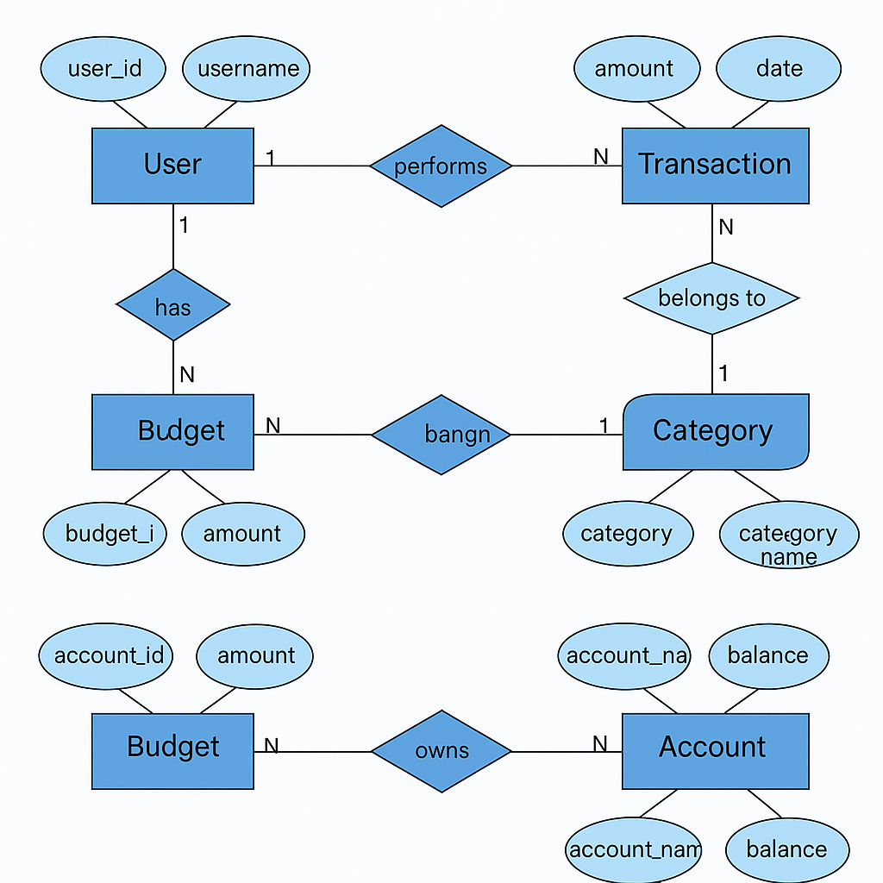
Er diagram

Slide 11
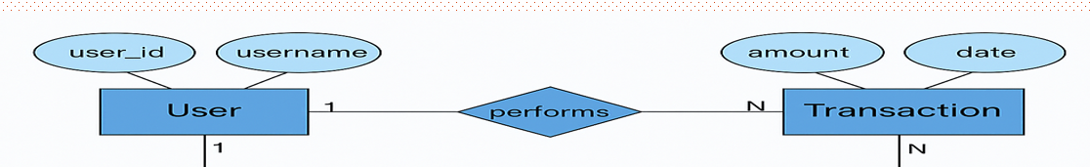
Er diagram to relations
USER-
User(user_id PK, username)

Slide 12
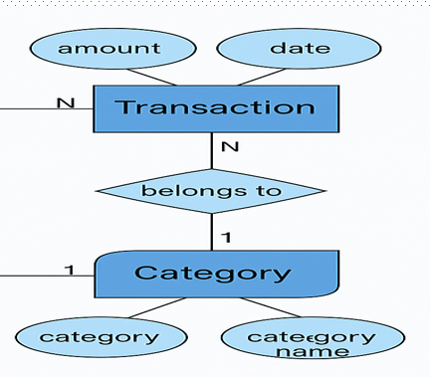
Transaction-
Transaction(transaction_id PK, user_id FK, category_id FK, amount, date)
user_id → references User(user_id)
category_id → references Category(category_id)

Slide 13
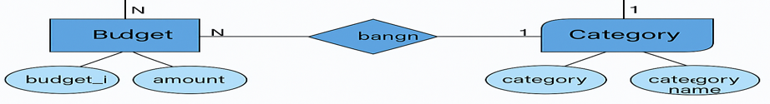
Category-
Category(category_id PK, category_name)

Slide 14
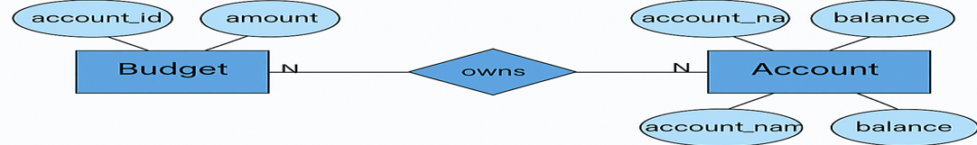
Budget-
Budget(budget_id PK, user_id FK, category_id FK, account_id FK, amount)
user_id → references User(user_id)
category_id → references Category(category_id)
account_id → references Account(account_id)

Slide 15
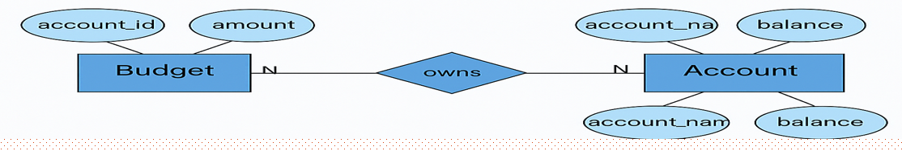
Account-
Account(account_id PK, account_name, balance)

Slide 16
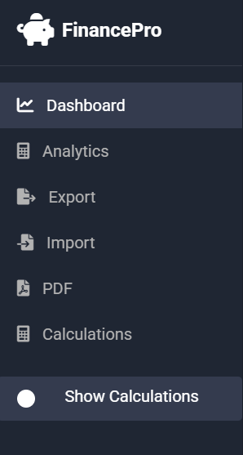
Frontend
📊 Dashboard
Purpose:
The Dashboard is the user's financial home screen
What it shows:
Total Income: All money added
Total Expenses: All money spent
Net Balance: The difference between income and expenses
A quick snapshot of your overall financial health
Why it matters:
It helps users instantly understand their financial status without checking individual records.

Slide 17
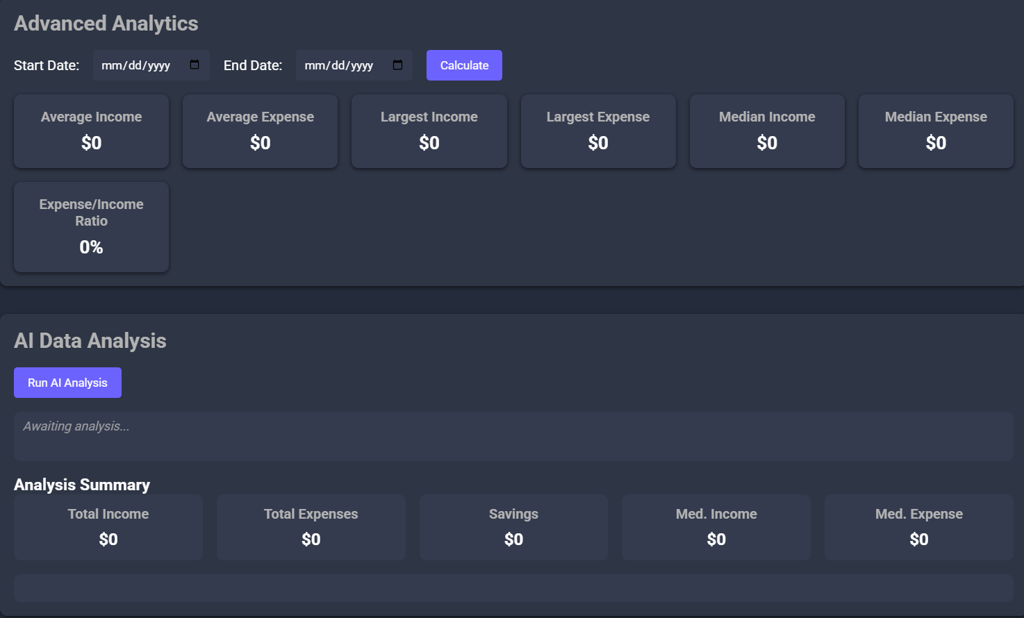
📈 Analytics
Purpose:
To visually represent income and expenses across different categories.
What it shows:
Pie charts or bar graphs showing spending by category (e.g., Food, Transport)
Monthly income vs expenses comparisons
Why it matters:
Visuals make it easier to identify spending patterns and areas where users can save money.

Slide 18

📤 Export
Purpose:
To allow users to download their financial data.
What it does:
Exports data to formats like CSV, Excel, or JSON
Users can store, share, or analyze data outside the app
Why it matters:
Great for backup, sharing with advisors, or doing custom analysis in Excel or Google Sheets.

Slide 19
📥 Import
Purpose:
To upload financial records into the system easily.
What it does:
Lets users upload files (e.g., bank statements or old transaction logs)
Reads data and inserts it into the app automatically
Why it matters:
Saves time — no need to enter data manually. Supports smooth migration from other finance tools.

Slide 20
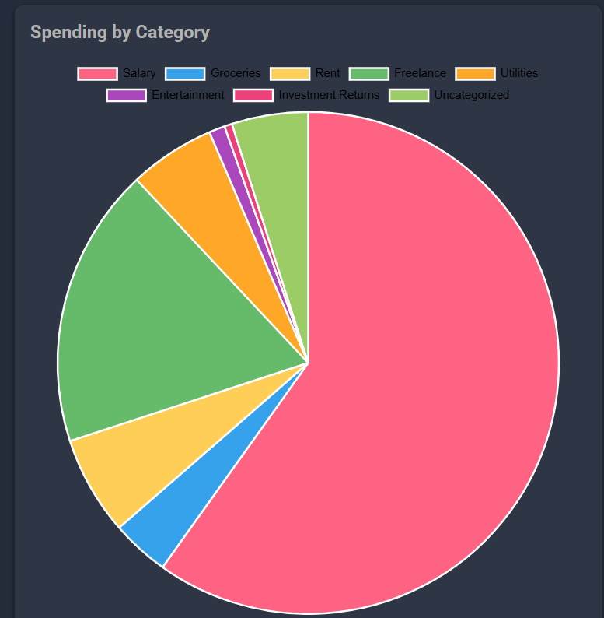
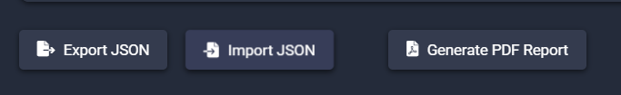
📄 PDF
Purpose:
To create printable or shareable reports.
What it does:
Generates PDF reports of budgets, expenses, or summaries
Ideal for official use or regular tracking
Why it matters:
Gives users a professional document they can archive or present to financial planners or accountants.

Slide 21
Normalization
Normalization is a process used to organize a database efficiently.
It helps in reducing data redundancy and dependency by organizing data into multiple related tables.
Normalization ensures that each table contains data about a specific topic, and that relationships between tables are defined by foreign keys.
There are several normal forms (NF) used in database normalization, with each subsequent normal form building upon the previous one:
First Normal Form (1NF): Ensures that each column contains atomic values, meaning there are no repeating groups or arrays. Each column should contain only a single value, and each value should be of the same data type.

Slide 22
Normalization
Second Normal Form (2NF): Requires that the database is in 1NF and that all non-key attributes are fully functional dependent on the primary key. This means that no partial dependencies exist; every non-key attribute must depend on the entire primary key.
Third Normal Form (3NF): Requires that the database is in 2NF and that there are no transitive dependencies. A transitive dependency exists when a non-key attribute depends on another non-key attribute, which in turn depends on the primary key.

Slide 23
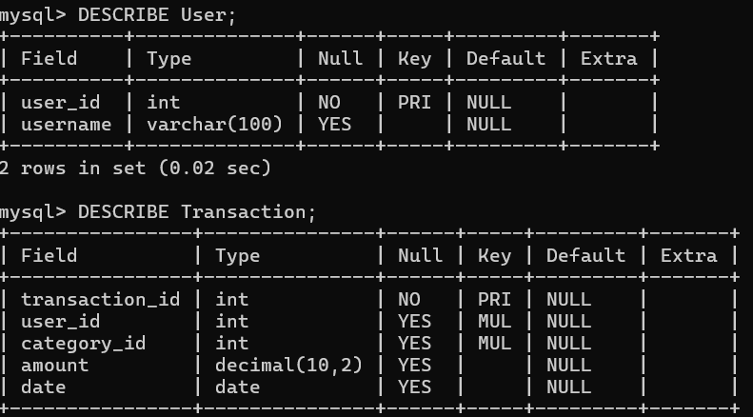
2nf
Transaction
Depends on:
User (via user_id)
Category (via category_id)
Budget
Depends on:
User (via user_id)
Category (via category_id)
Account (via account_id)

Slide 24
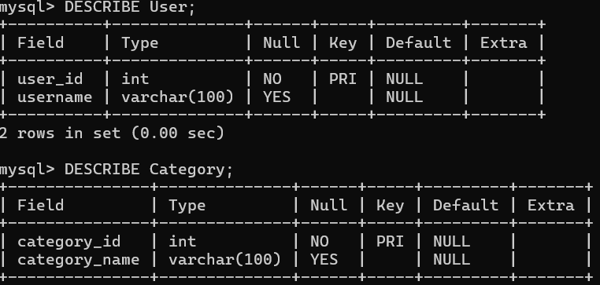
3nf
Transaction Table
🟡 Depends on:
User (via user_id)
Category (via category_id)
📌 Meaning: Every transaction belongs to a user and has a specific category (like “Food” or “Salary”).
Budget Table
🟡 Depends on:
User (via user_id)
Category (via category_id)
Account (via account_id)
📌 Meaning: Each budget is set by a user, for a category (e.g. Travel), and linked to an account (e.g. Bank account).

Slide 25
conclusion
The FinancePro system is a powerful tool for managing personal finances. By using best practices in database normalization and creating a clear separation of concerns, the system is capable of efficiently handling large volumes of data while keeping things organized. This project not only simplifies personal finance management but also provides users with the tools they need to make informed financial decisions, ultimately leading to better financial well-being

Slide 26
Thank you!

